Slide 1

Welcome
Adult Out of Court Resolutions
Overview For Legal Advisors

Slide 2
Aims & Objectives
Understand what Out of Court Resolutions (OOCR) there are
Examine some of the criteria for when OOCR may be considered
Appreciate how the Police make OOCR decisions
Recognise the advantages of using OOCR over other outcomes
Consider the role of the legal advisor in OOCR decisions
Learn about OOCR Scrutiny & Governance
Be aware of future national changes coming to Adult OOCR

Slide 3

What Is An OOCR?
HELLO
MY NAME IS
An alternative way for the Police and/or CPS to finalise or resolve an investigation without going to Court

Slide 4
Current Adult OOCR Framework
D
I
V
E
R
S
I
O
N
Community Resolution
Informal OOCR for mainly low-level offences
Simple Caution
Conditional Caution
GMP’s primary choice for a caution
Cannabis/Khat Warning
No longer used in GMP
Penalty Notice
Used only for DA medium risk and hate crime
No longer used in GMP
D
E
F
E
R
R
E
D
S
C
H
E
M
E
S

Slide 5
Community Resolution
 | Who makes the decision to offer the OOCR and how? | For what offences can the OOCR be considered? | Can a suspect’s previous offending history impact the OOCR decision? | Does the suspect have to accept responsibility or admit guilt to be considered for the OOCR? | Does the victim of the offence(s) have to agree to the OOCR? | Would the suspect be required to complete any conditions as part of the OOCR? | What might happen if the suspect does not comply with any of the OOCR conditions? | What is the impact of accepting the OOCR on a suspect’s criminal record?
Community Resolution | Police decision. Cases considered in line with Gravity Factor Matrix, local Force and NPCC policy/guidance. Clear a crime has occurred & evidence to suspect offender., OOCR in public interest. | Intended mainly for lower-level or less serious offences. Cannot be considered for certain excluded offences eg) intimate DA, indictable only offences. | Previous ‘relevant offending’ may impact on whether the outcome can be offered. Supervisors may apply discretion on a case-by-case basis. | One of the eligibility requirements for this outcome is that the suspect has accepted responsibility for their offending behaviour. Suspect must also agree to accept the OOCR. | The views and wishes of any victims will be sought and considered, however the decision to offer an OOCR rests with the Police or CPS. | Yes. The OOCR will be given with one or more conditions which can be; reparative, rehabilitative, restorative or restrictive. eg; a specific diversionary or educational activity, paying compensation etc | All conditions set are voluntary. There is no specific power of arrest or detention for failing to complete the OOCR conditions. | Details held on local policing systems. May in certain instances be disclosed in an enhanced Disclosure and Barring Service (DBS) check.

Slide 6
Simple Caution- DA medium risk and hate crime only
 | Who makes the decision to offer the OOCR and how? | For what offences can the OOCR be considered? | Can a suspect’s previous offending history impact the OOCR decision? | Does the suspect have to accept responsibility or admit guilt to be considered for the OOCR? | Does the victim of the offence(s) have to agree to the OOCR? | Would the suspect be required to complete any conditions as part of the OOCR? | What might happen if the suspect does not comply with any of the OOCR conditions? | What is the impact of accepting the OOCR on a suspect’s criminal record?
Simple Caution | Police or CPS decision. Cases considered in line with Gravity Factor Matrix, Force policy, Ministry of Justice Codes of Practice and CPS guidance. Apply CPS Full Code Test. | Can be considered for most summary only and either way offences with some exceptions. Use with indictable only offences needs DPP consent. May not be used by some Forces, or may only be used for very specific offences. | Previous cautions and convictions (particularly in last 2 yrs) may impact on whether the outcome can be considered, however they are not an automatic bar to using the OOCR if exceptional circumstances exist. | One of the eligibility requirements for this outcome is that the suspect has made a full (PACE compliant) admission to the offence(s). Suspect must also agree to accept the OOCR. | The views and wishes of any victims will be sought and considered, however the decision to offer an OOCR rests with the Police or CPS. | No. Conditions are not mandatory however a DA perpetrator programme will be offered for SA medium risk | N/A. Conditions are not mandatory with this OOCR. | Details held on PNC and local policing systems. “Spent” immediately. May be disclosed in future legal proceedings or in a standard or enhanced DBS check.

Slide 7
Conditional Caution
 | Who makes the decision to offer the OOCR and how? | For what offences can the OOCR be considered? | Can a suspect’s previous offending history impact the OOCR decision? | Does the suspect have to accept responsibility or admit guilt to be considered for the OOCR? | Does the victim of the offence(s) have to agree to the OOCR? | Would the suspect be required to complete any conditions as part of the OOCR? | What might happen if the suspect does not comply with any of the OOCR conditions? | What is the impact of accepting the OOCR on a suspect’s criminal record?
Conditional Caution | Police or CPS decision. Cases considered in line with Gravity Factor Matrix, Force policy, Ministry of Justice Codes of Practice and CPS guidance. Apply CPS Full Code Test. | Can be considered for most summary & either way offences with some exceptions eg) where prison or a high-level community order would be likely if prosecuted & convicted. Use with indictable only offences needs DPP consent. | Previous cautions and convictions (particularly in last 2 yrs) may impact on whether the outcome can be considered, however they are not an automatic bar to using the OOCR if exceptional circumstances exist. | One of the eligibility requirements for this outcome is that the suspect has made a full (PACE compliant) admission to the offence(s). Suspect must also agree to accept the OOCR. | The views and wishes of any victims will be sought and considered, however the decision to offer an OOCR rests with the Police or CPS. | Yes. The OOCR will be given with one or more conditions which can be; reparative, rehabilitative, punitive, restorative or restrictive. eg; a specific diversionary or educational activity, paying compensation or a fine etc | Where any conditions are not complied with the suspect may be prosecuted for the original offence. There is a power of arrest and detention for failing to complete the OOCR conditions. | Details held on PNC and local policing systems. “Spent” on completion or after 3 months. May be disclosed in future legal proceedings or basic (for 3 months), standard or enhanced DBS check.

Slide 8
OOCR Conditions
Reparative
Compensation
Repair, replace or make good
Rehabilitative
Diversionary, rehabilitative or educational intervention
Location
Restrictive
Person
Apology
Restorative Justice
Foreign Offender Conditions
Used with Conditional Cautions to bring about departure from UK and ensure non-return for a specified period

Slide 9
Complexities of Decision Making
Victim
Impact on victim & wider community
Views & wishes
Vulnerabilities & needs
Safeguarding
Evidence & Public Interest
Evidential Test met
  Sufficient, Admissible, Reliable, Credible
Public Interest Factors considered
  Proportionality
  Seriousness
  Culpability
  Harm
  Impact on Community
  Proportionality
  Sources of Information
Offence
Seriousness & risk
Circumstances
Aggravating & mitigating factors
Likely outcome if proceeded to Court
Offender
Admissions/acceptance of responsibility
Vulnerabilities & needs
Offending history
Other Factors
Availability of suitable conditions
Achieving Justice in the case
What would the Public think?
Policies & Guidance
Local, NPCC, MoJ, CPS
Gravity Factor Matrix
Sentencing Guidelines
Victim
Public Interest
Evidence
Offence
Policies & Guidance
Other Factors
Offender

Slide 10
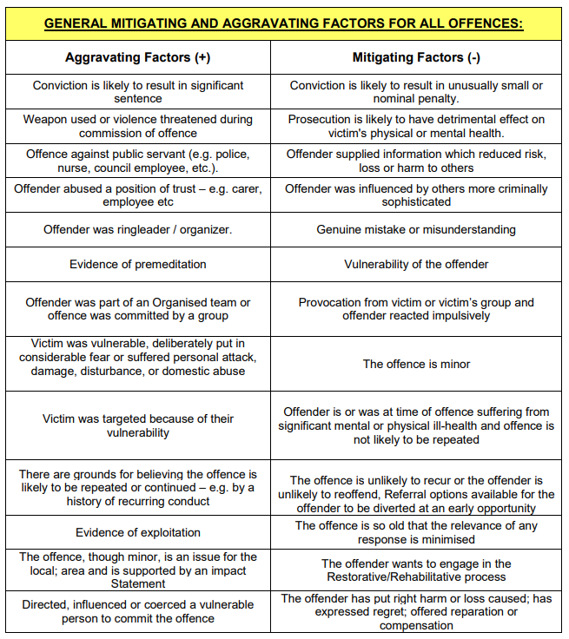
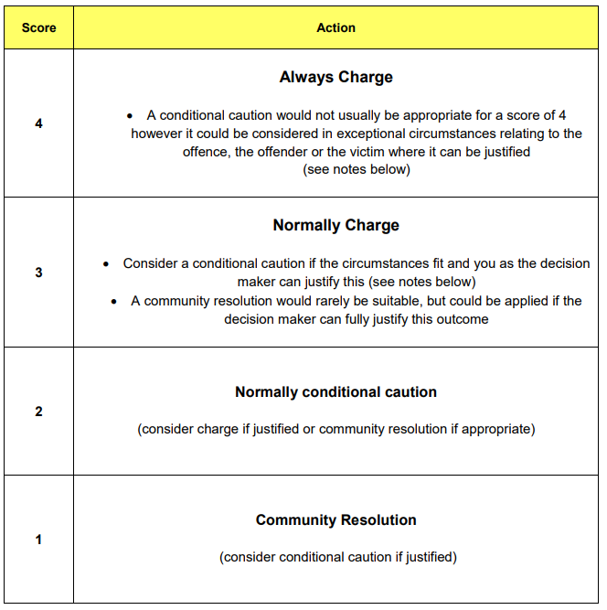
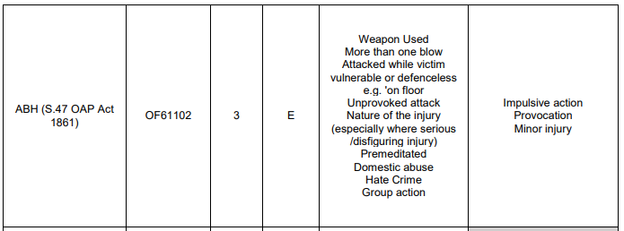
Gravity Factor Matrix
Adult Gravity Matrix (2013) - https://www.npcc.police.uk/SysSiteAssets/media/downloads/publications/publications-log/criminal-justice/2026/adult-gravity-factor-matrix-v3-2013.pdf)
Adult Gravity Matrix (2019) – https://www.npcc.police.uk/SysSiteAssets/media/downloads/publications/publications-log/criminal-justice/2026/adult-gravity-matrix-v4-2019.pdf

Slide 11
Why OOCR?
Criminal Record
Avoid Court
Immediate Outcome
Reduced Reoffending
Support for Offender Needs
Early Reparation

Slide 12
Role of Legal Advisor in OOCR
Legal advice and protecting rights & best interests of client
  advising whether evidence supports the offence
  advising whether the client should admit guilt or not (often a prerequisite for OOCR)
  ensuring client’s understanding of any OOCR offered and the implications of accepting it
Negotiation and representation
  suggesting OOCR in appropriate cases
  making representations on suitability or unsuitability of OOCR in client’s best interests
  negotiating type of OOCR or conditions attached
Ensuring fair process
  making sure OOCR use is appropriate, justified and proportionate

Slide 13
Scrutiny & Governance
Internal Scrutiny & Governance
e.g. dip sampling, effectiveness reporting
e.g. disproportionality analysis
External Scrutiny
e.g. ONS Outcomes Open Data Tables
e.g. Transform Justice
Independent Scrutiny Panels
National Policy
& Reform of OOCR
NPCC OOCR Lead
Ministry of Justice
& CPS

Slide 14
Future Adult OOCR Framework?
Police Crime Sentencing & Courts Act 2022
Existing Adult OOCR will be abolished
(except Community Resolution)
New Two Tier+ Adult OOCR Framework
National changes to Adult OOCR (NOT YET LIVE)…. 2027?
  Community Resolution,
  Two new Adult Cautions,
  Diversionary Cautions
  Community Cautions
(All must have condition(s) attached)

